Slide 1
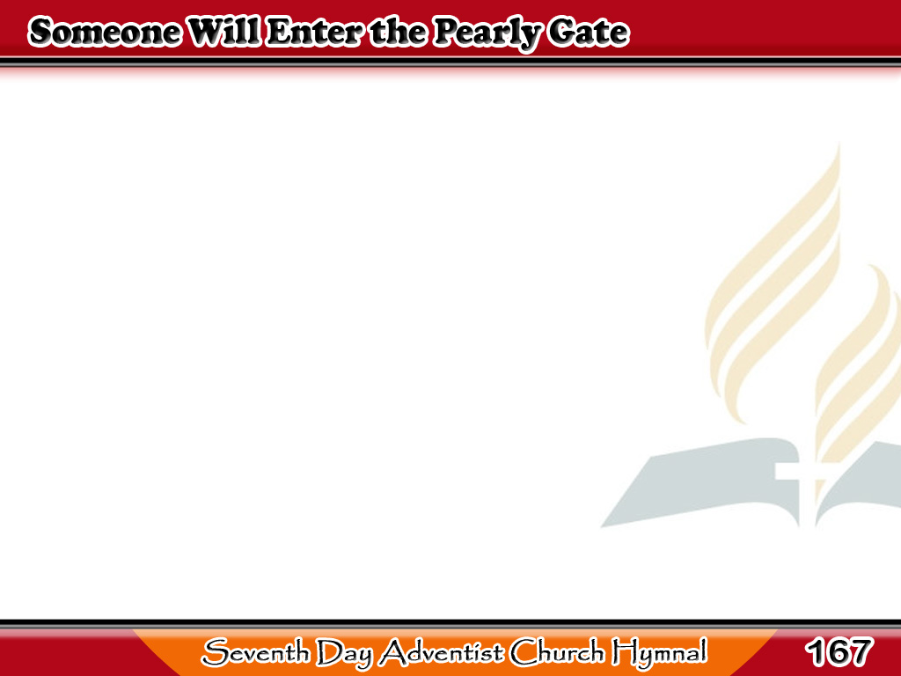
May Papasok Din sa Pintuan
Someone will enter
the pearly gate
By and by, by and by,
1/4

Slide 2
May Papasok Din sa Pintuan
Taste of the glories
that there await,
Shall you? shall I?
Shall you? shall I?
1/4

Slide 3
May Papasok Din sa Pintuan
Someone will travel
the streets of gold,
Beautiful visions
will there behold,
1/4

Slide 4
May Papasok Din sa Pintuan
Feast on the pleasures
so long foretold;
Shall you? shall I?
Shall you? shall I?
1/4

Slide 5
May Papasok Din sa Pintuan
Someone will gladly
his cross lay down
By and by, by and by,
2/4

Slide 6
May Papasok Din sa Pintuan
Faithful, approved,
shall receive a crown,
Shall you? shall I?
Shall you? shall I?
2/4

Slide 7
May Papasok Din sa Pintuan
Someone the glorious King
will see,
Ever from sorrow
of earth be free,
2/4

Slide 8
May Papasok Din sa Pintuan
Happy with Him
through eternity;
Shall you? shall I?
Shall you? shall I?
2/4

Slide 9
May Papasok Din sa Pintuan
Someone will knock
when the door is shut
By and by, by and by,
3/4

Slide 10
May Papasok Din sa Pintuan
Hear a voice saying,
“I know you not,”
Shall you? shall I?
Shall you? shall I?
3/4

Slide 11
May Papasok Din sa Pintuan
Someone will call
and shall not be heard,
Vainly will strive
when the door is barred,
3/4

Slide 12
May Papasok Din sa Pintuan
Someone will fail
of the saints’ reward;
Shall you? shall I?
Shall you? shall I?
3/4

Slide 13
May Papasok Din sa Pintuan
Someone will sing
the triumphant song
By and by, by and by,
4/4

Slide 14
May Papasok Din sa Pintuan
Join in the praise with
the blood bought throng;
Shall you? shall I?
Shall you? shall I?
4/4

Slide 15
May Papasok Din sa Pintuan
Someone will greet
on the golden shore,
Loved ones of earth,
pain and parting o’er,
4/4

Slide 16
May Papasok Din sa Pintuan
Safe in the glory forevermore;
Shall you? shall I?
Shall you? shall I?
4/4

